Slide 1

Northern Arizona University
Presentors:
Michael Schubert
Matthew Vigil

Slide 2
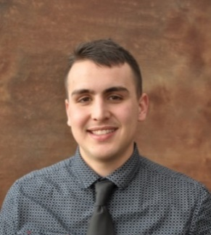





Project Manager
Matthew Vigil
Goals:
Renovate hull design
Brand new mix design
Sustainable building set-up
Project Engineer
Katrina Shurley
Materials Engineer
Michael Schubert
Reinforcement Engineer
Cristopher Aguilar
Structural Engineer
Stephanie Croker

Slide 3

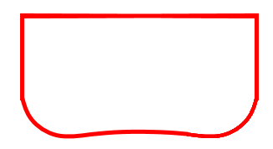
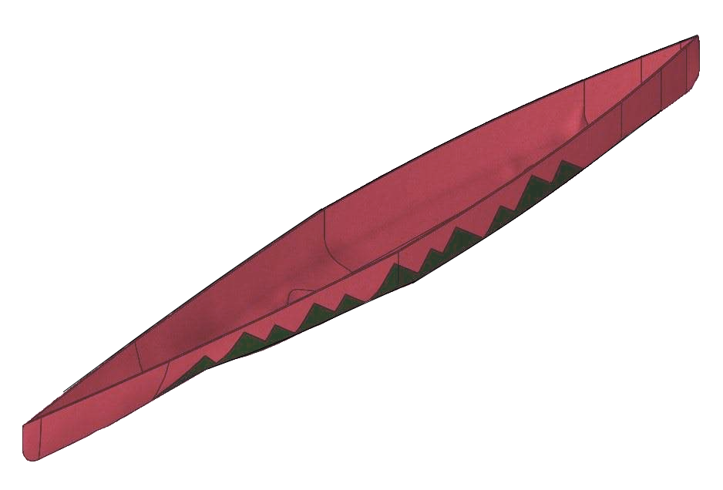

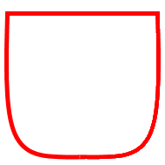
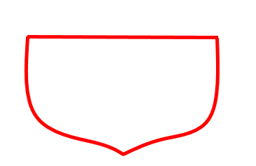
Hull Dimensions
Length | 252 in
Width | 28 in
Height | 16 in
Shallow Concave Bottom
Flat Bottom
V-Shape
Curved Keel Sailboat

Slide 4
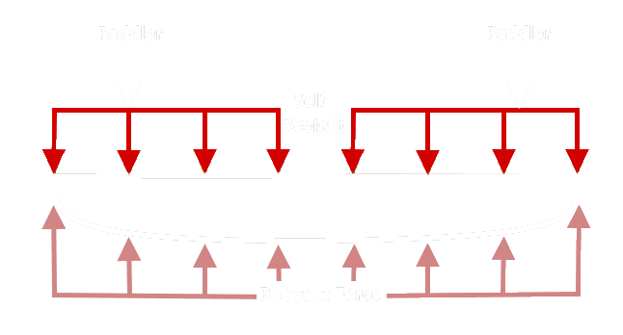
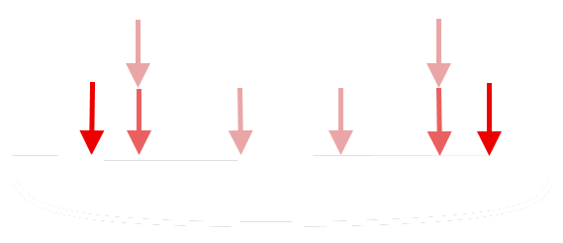
Scenario | Tensile Stress (psi) | Compressive Stress (psi)
Closest To Bow and Stern | 32.2 | 83.6
2-Person | 34.4 | 13.3
4-Person | 102.5 | 39.5

Slide 5

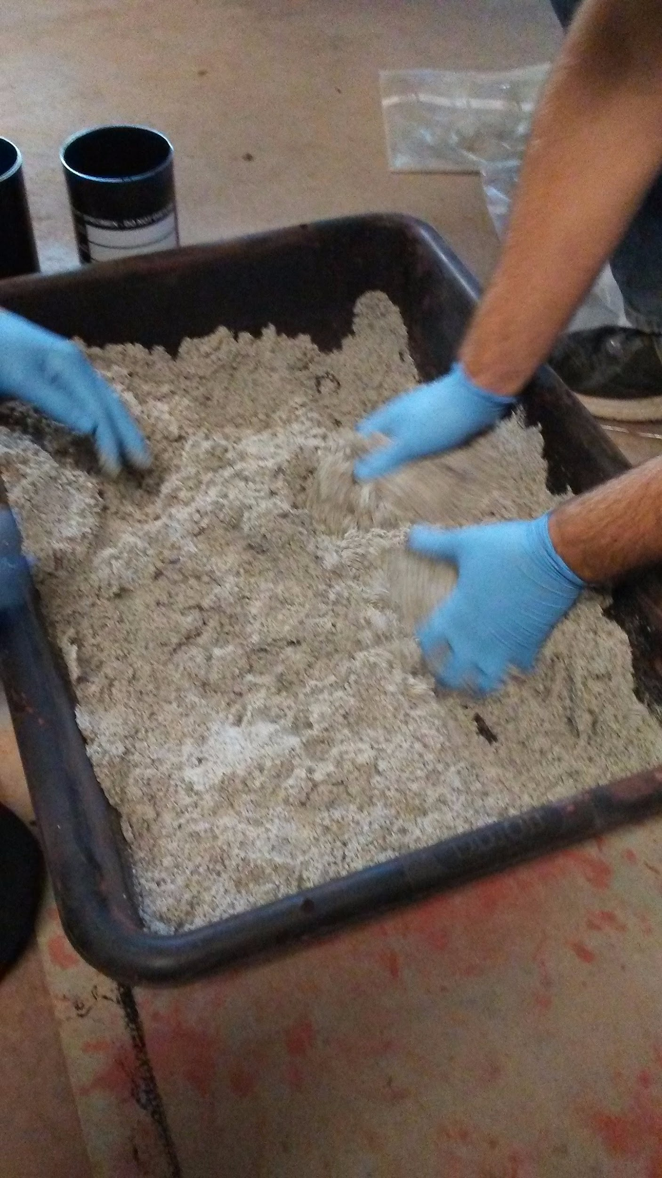
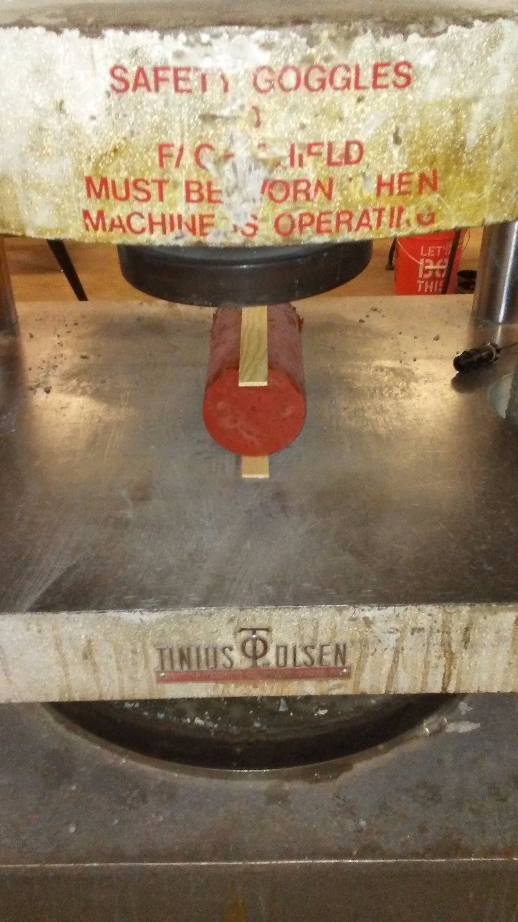
Finishing Mix
Wet Unit Weight | 77.8 lb/ft³
Oven-Dry Unit Weight | 64.8 lb/ft³
28-Day Compressive Strength | 3547.0 psi
28-Day Tensile Strength | 321.9 psi
Concrete Air Content | 19%
Structural Mix
Wet Unit Weight | 60.3 lb/ft³
Oven-Dry Unit Weight | 53.9 lb/ft³
28-Day Compressive Strength | 1939.0 psi
28-Day Tensile Strength | 218.1 psi
28-Day Flexural Strength | 827.4 psi
Concrete Air Content | 11%

Slide 6
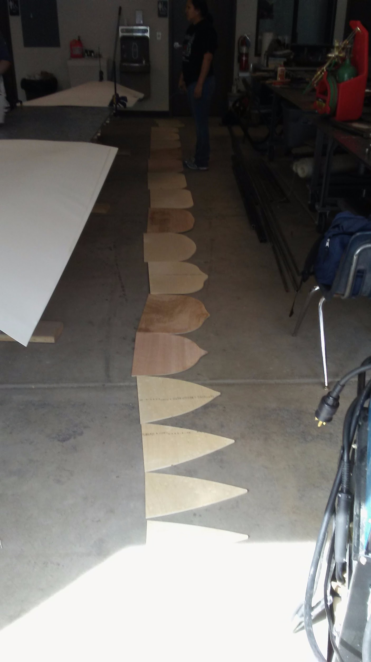
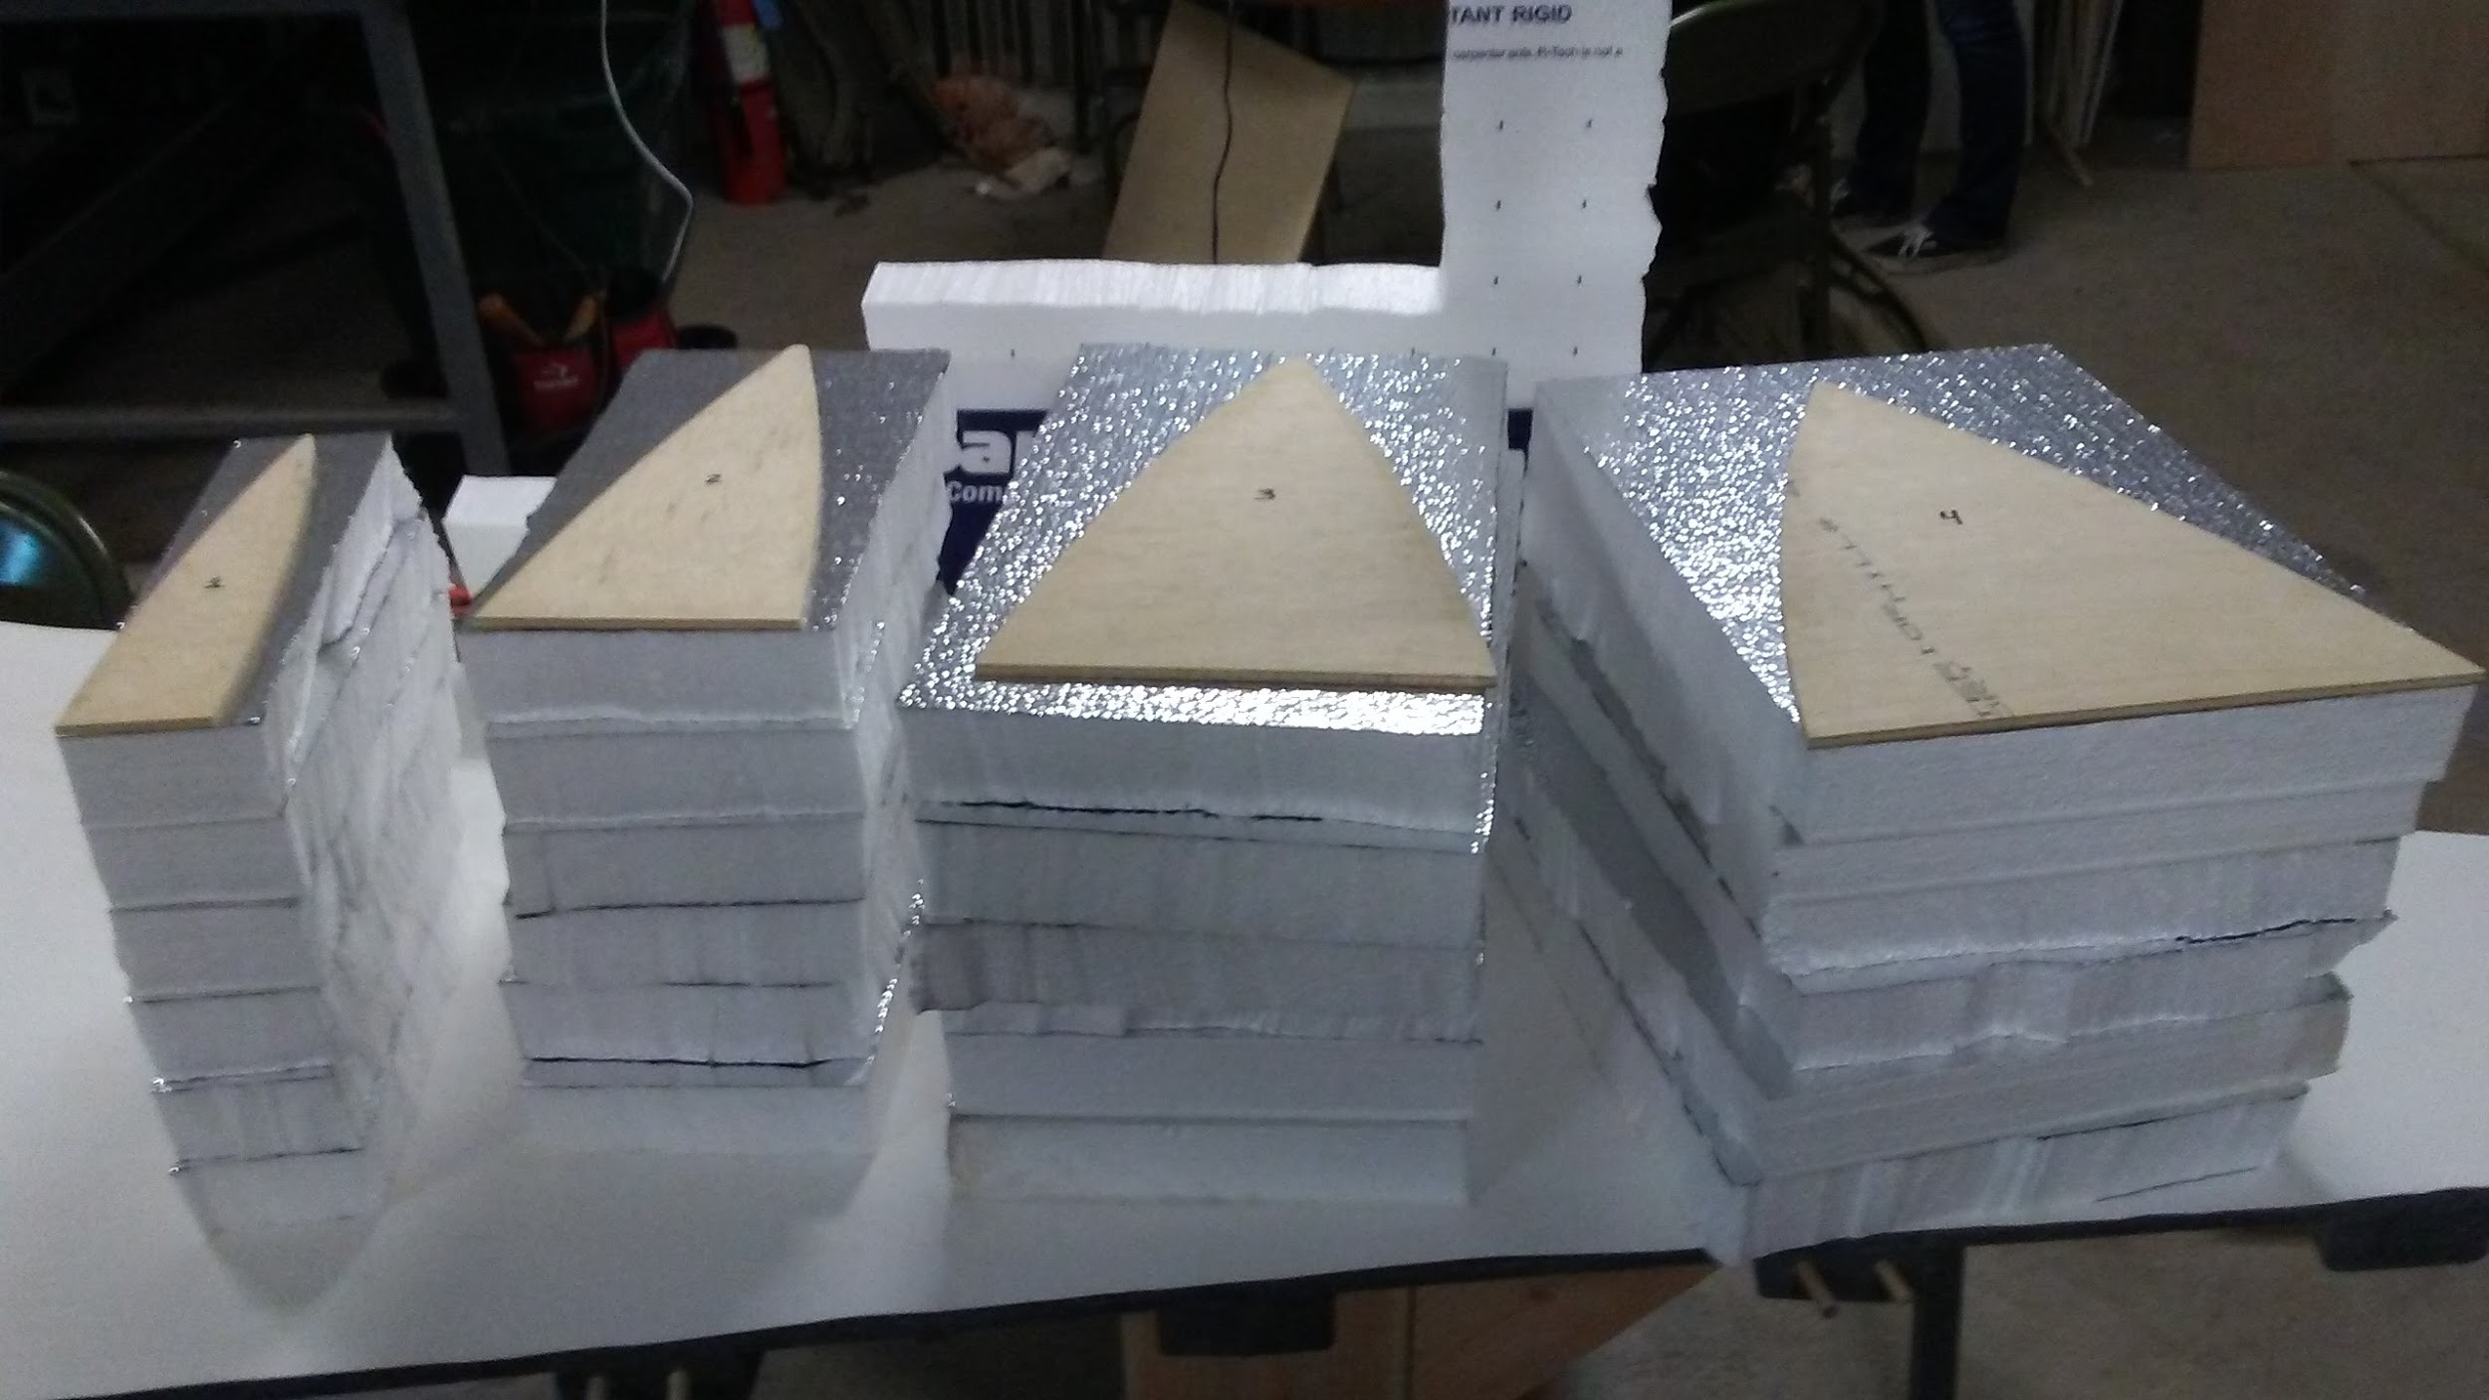
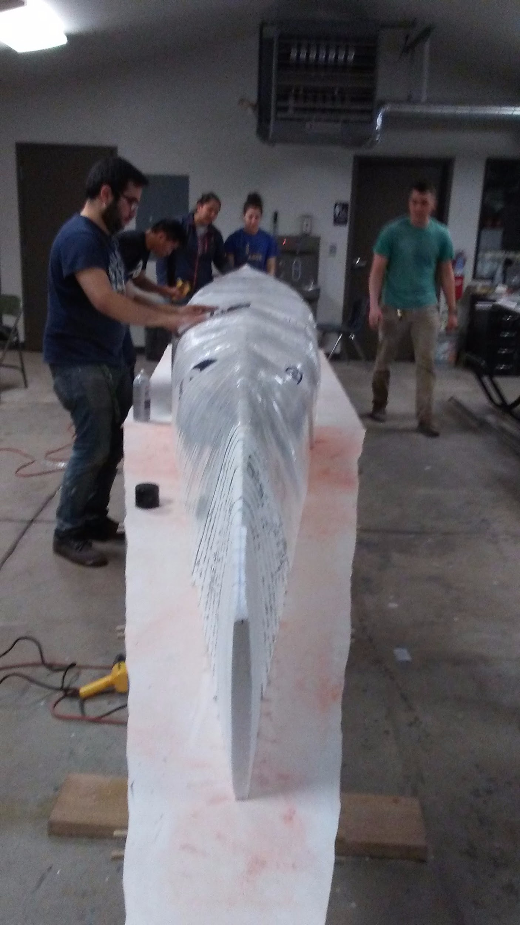
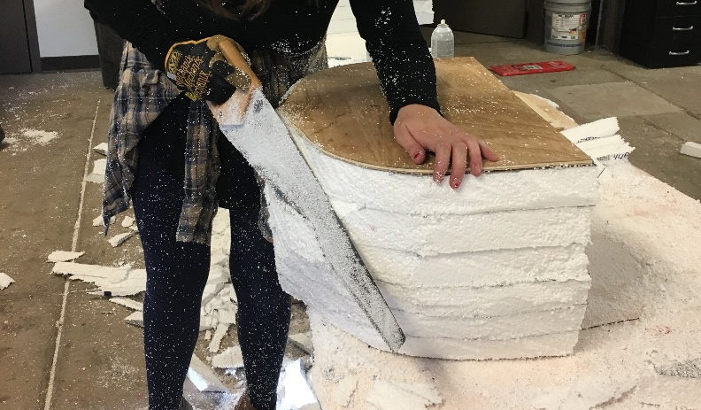

Slide 7
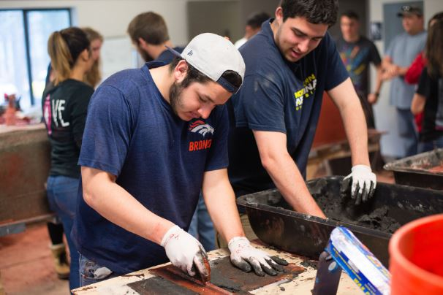
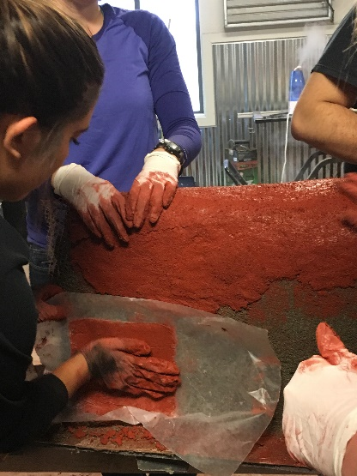

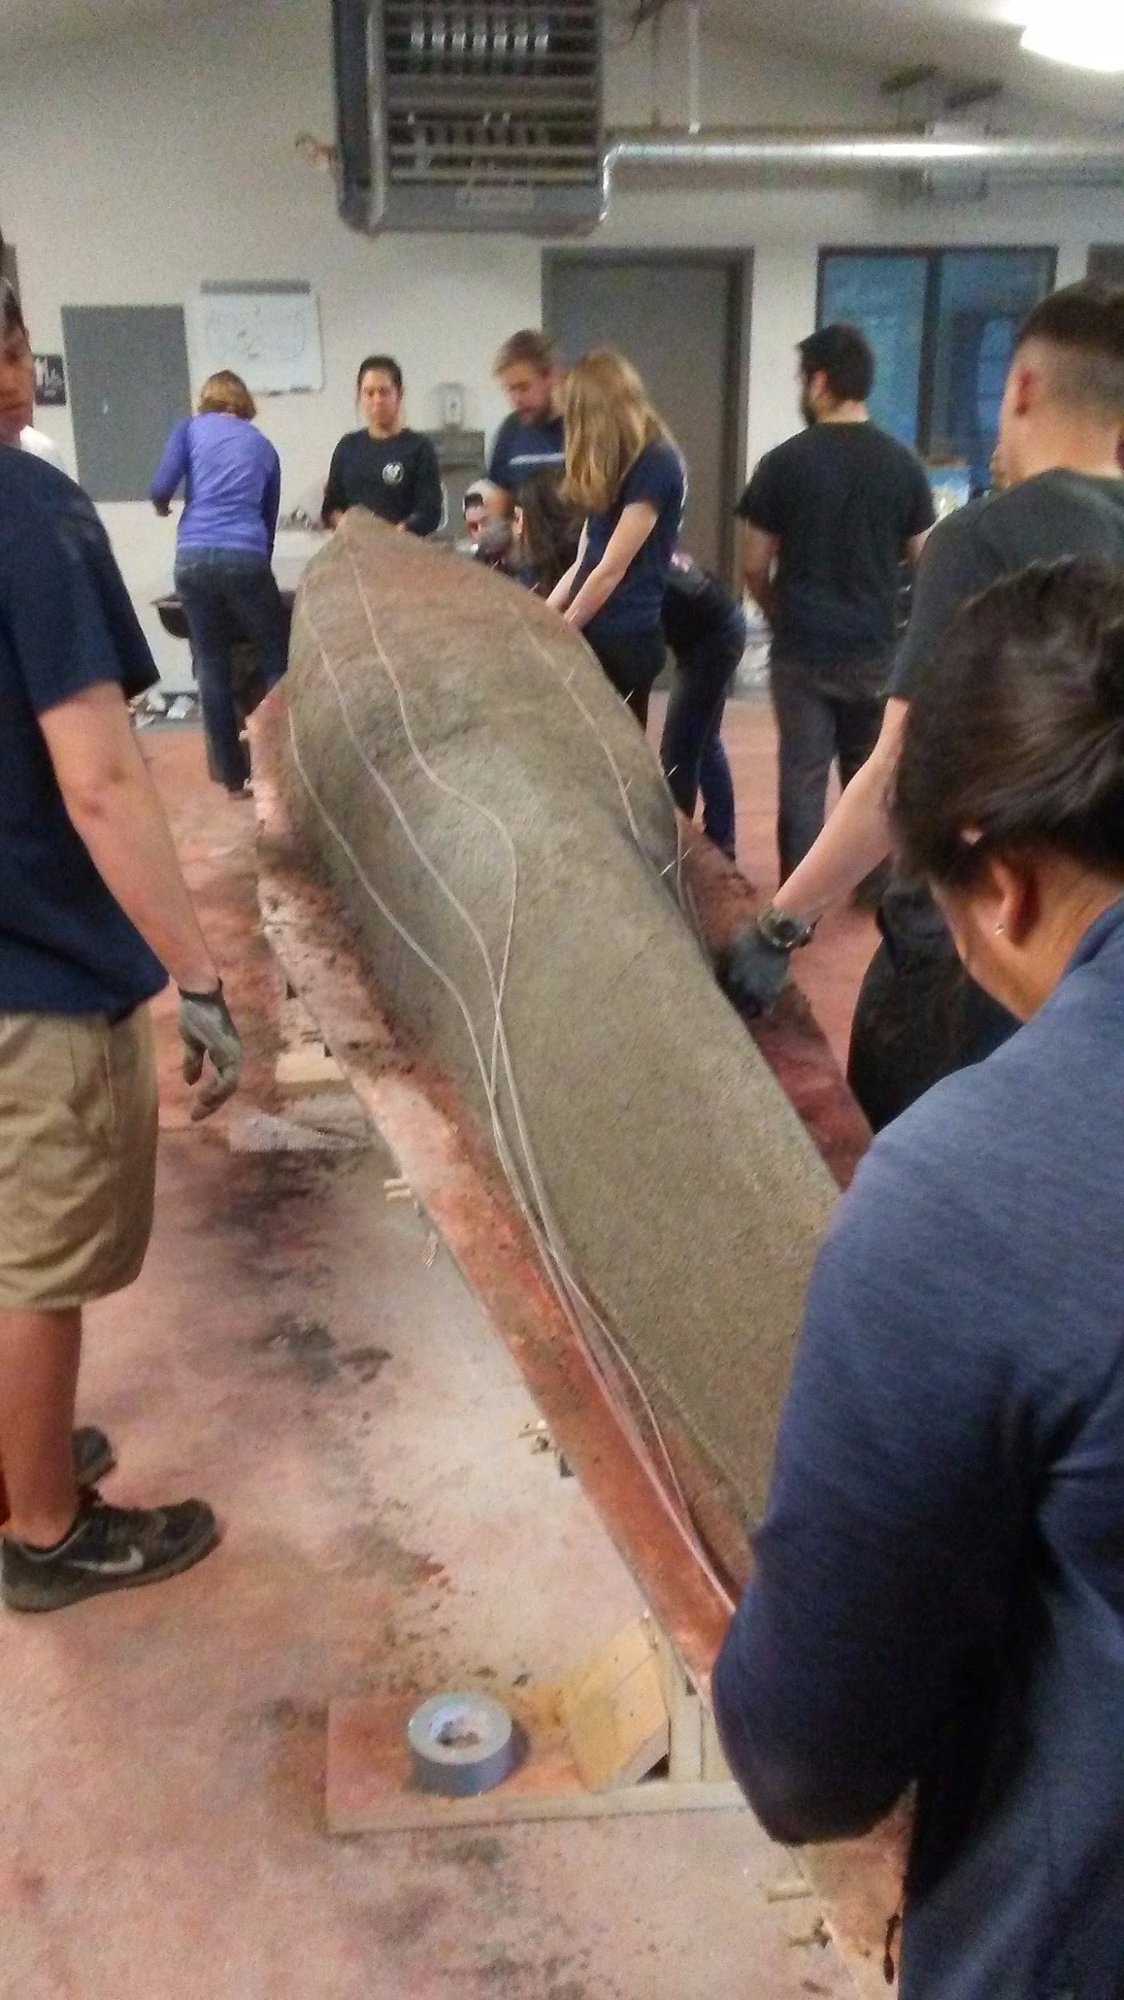
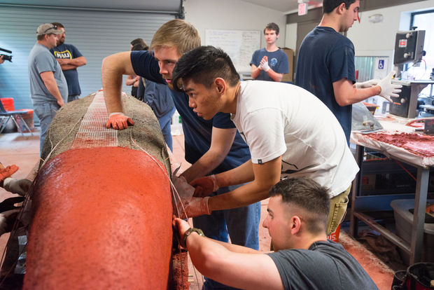

Slide 8

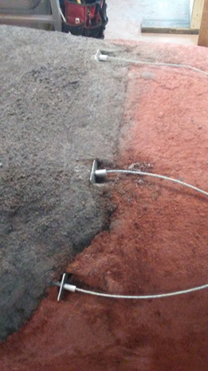
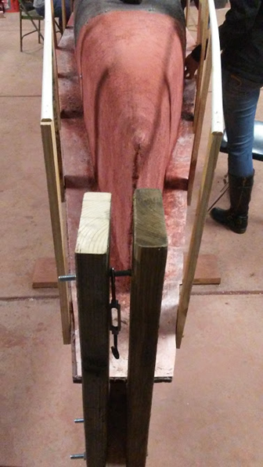
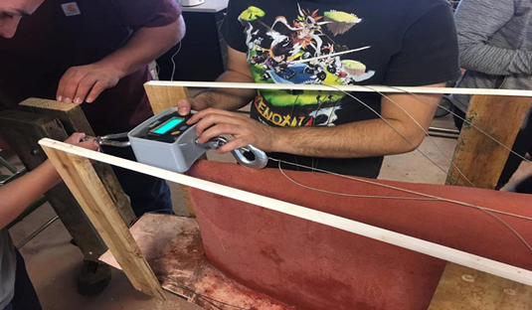
Wires | Projected (lb) | Expected after losses (lb)
Top | 100 | 80
Middle | 100 | 70
Bottom | 100 | 70

Slide 9
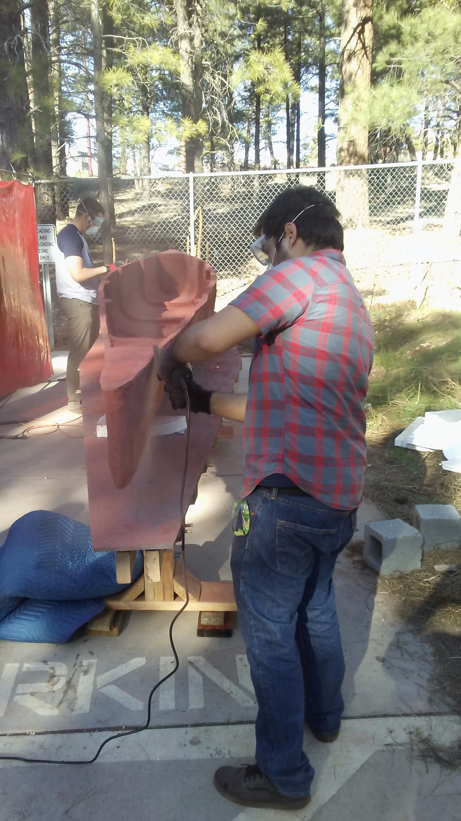

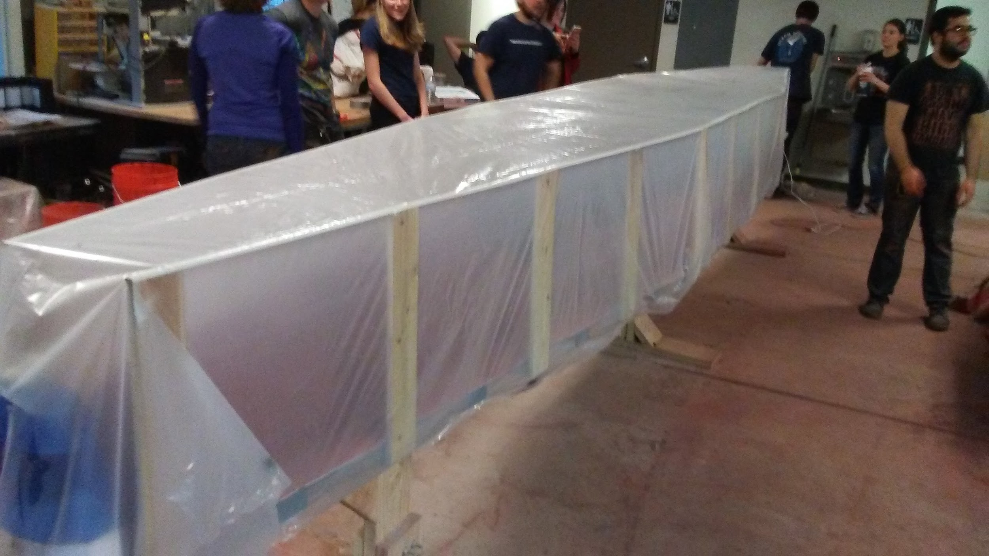
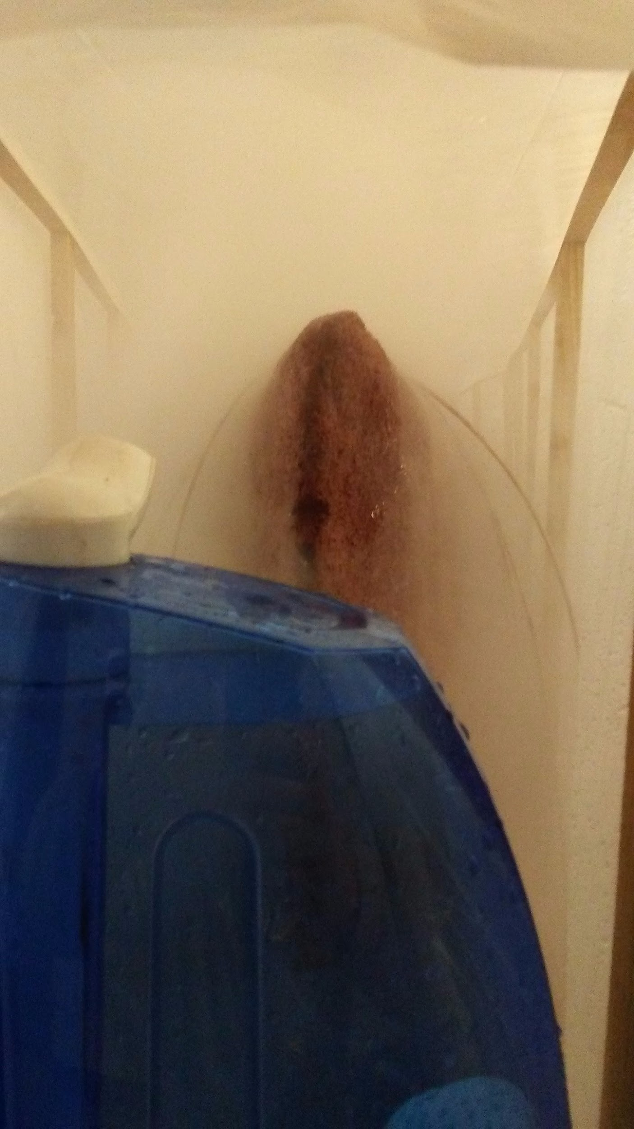
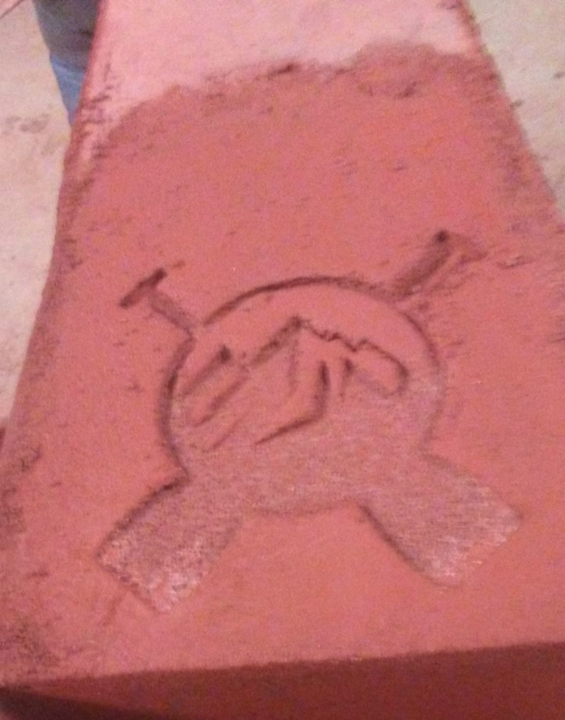

Slide 10

